Slide 1

컴퓨터구조
Lecture 5
Designing a Single Cycle Data path
Notes:
Start: X:40

Slide 2

The Big Picture: Where are We Now?
The Five Classic Components of a Computer
Today’s Topic: Design a Single Cycle Processor
Processor
Input
Control
Memory
Datapath
Output
machine
design
Arithmetic (L4-6)
inst. set design (L1-2)
technology (L3)
Notes:
Before we go any further, let’s step back for a second and take a look at the big picture.
All computer consist of five components: (1) Input and (2) output devices. (3) The Memory System. And the (4) Control and (5) Datapath of the Processor.
Today’s lecture covers the datapath design.
In Friday’s lecture, we will show you how to design the processor’s control unit.
+1 = 5 min. (X:45)

Slide 3
CPU Organization (Design)
Processor
Input
Control
Memory
  Control Unit Design:
  Logic and means by which such information flow is controlled.
  Control and coordination of FUs operation to realize the targeted Instruction Set Architecture to be implemented (can either be implemented using a finite state machine or a microprogram).
Datapath
Output
  Data Path Design :
  Capabilities & performance characteristics of principal Functional Units (FUs) and components needed by ISA instructions (e.g., Registers, ALU, Shifters, Logic Units, ...)
  Ways in which these components are interconnected and how information flows between components (buses connections, multiplexors, etc.).

Slide 4
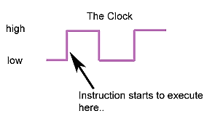
The Big Picture: The Performance Perspective
Performance of a machine is determined by:
  Instruction count
  Clock cycle time
  Clock cycles per instruction
Processor design (datapath and control) will determine:
  Clock cycle time
  Clock cycles per instruction
Today:
  Single cycle processor:
    Advantage: One clock cycle per instruction
    Disadvantage: long cycle time
CPI
Inst. Count
Cycle Time
Notes:
This slide shows how the next two lectures fit into the overall performance picture.
Recalled from one of your earlier lectures that the performance of a machine is determined by 3 factors: (a) Instruction count, (b) Clock cycle time, and (c) Clock cycles per instruction.
Instruction count is controlled by the Instruction Set Architecture and the compiler design so the computer engineer has very little control over it (Instruction Count).
What you as a computer engineer can control, while you are designing a processor, are the Clock Cycle Time and Instruction Count per cycle.
More specifically, in the next two lectures, you will be designing a single cycle processor which by definition takes one clock cycle to execute every instruction.
The disadvantage of this single cycle processor design is that it has a long cycle time.
+2 = 7 min. (X:47)

Slide 5

How to Design a Processor: step-by-step
1. Analyze instruction set => datapath requirements
  the meaning of each instruction is given by the register transfers
  datapath must include storage element for ISA registers
    possibly more
  datapath must support each register transfer
2. Select set of datapath components and establish clocking methodology
3. Assemble datapath meeting the requirements
4. Analyze implementation of each instruction to determine setting of control points that effects the register transfer.
5. Assemble the control logic

Slide 6
CPU Design & Implantation Process
Top-down Design:
  Specify component behavior from high-level requirements (ISA).
Bottom-up Design:
  Assemble components in target technology to establish critical timing (hardware delays, critical path timing).
Iterative refinement:
  Establish a partial solution, expand and improve.
Instruction Set
Architecture (ISA):
Provides
Requirements
Processor
ISA Requirements
CPU Design
Datapath
Control
Reg. File
Mux
ALU
Reg
Mem
Decoder
Sequencer
Target VLSI implementation
Technology
Cells
Gates

Slide 7
Datapath Design Steps
Write the micro-operation sequences required for a number of representative target ISA instructions using independent RTN.
Independent RTN statements specify: the required datapath components and how they are connected.
From the above, create an initial datapath by determining possible destinations for each data source (i.e registers, ALU).
  This establishes connectivity requirements (data paths, or connections) for datapath components.
  Whenever multiple sources are connected to a single input, a multiplexor of appropriate size is added.
Find the worst-time propagation delay (critical path) in the datapath to determine the datapath clock cycle (CPU clock cycle, C).
Complete the micro-operation sequences for all remaining instructions adding datapath components + connections/multiplexors as needed.
1
2
(or destination)

Slide 8
The MIPS Instruction Formats
All MIPS instructions are 32 bits long. The three instruction formats:
  R-type
  I-type
  J-type
The different fields are:
  op: operation of the instruction.
  rs, rt, rd: The source and destination register specifiers.
  shamt: shift amount
  funct: selects the variant of the operation in the “op” field
  address / immediate: address offset or immediate value
  target address: target address of the jump instruction
31
26
21
16
11
6
0
op
rs
rt
rd
shamt
funct
6 bits
5 bits
5 bits
5 bits
5 bits
6 bits
31
26
21
16
0
op
rs
rt
Immediate (imm16)
ALU,
Load/Store, Branch
6 bits
5 bits
5 bits
16 bits
Or address offset
31
26
0
Jumps
op
target address
6 bits
26 bits
Notes:
One of the most important thing you need to know before you start designing a processor is how the instructions look like.
Or in more technical term, you need to know the instruction format. One good thing about the MIPS instruction set is that it is very simple.
First of all, all MIPS instructions are 32 bits long and there are only three instruction formats: (a) R-type, (b) I-type, and (c) J-type.
The different fields of the R-type instructions are:
(a) OP specifies the operation of the instruction.
(b) Rs, Rt, and Rd are the source and destination register specifiers.
(c) Shamt specifies the amount you need to shift for the shift instructions.
(d) Funct selects the variant of the operation specified in the “op” field.
For the I-type instruction, bits 0 to 15 are used as an immediate field. I will show you how this immediate field is used differently by different instructions.
Finally for the J-type instruction, bits 0 to 25 become the target address of the jump.
+3 = 10 min. (X:50)

Slide 9
Step 1a: The MIPS-lite Subset for today
R-type :
31
26
21
16
11
6
0
ADD and SUB
  addU rd, rs, rt
  subU rd, rs, rt
OR Immediate:
  ori rt, rs, imm16
LOAD and STORE Word
  lw rt, rs, imm16
  sw rt, rs, imm16
BRANCH:
  beq rs, rt, imm16
op
rs
rt
rd
shamt
funct
6 bits
5 bits
5 bits
5 bits
5 bits
6 bits
I-type :
31
26
21
16
0
op
rs
rt
immediate
6 bits
5 bits
5 bits
16 bits
31
26
21
16
0
op
rs
rt
immediate
6 bits
5 bits
5 bits
16 bits
31
26
21
16
0
op
rs
rt
immediate
6 bits
5 bits
5 bits
16 bits
Notes:
In today’s lecture, I will show you how to implement the following subset of MIPS instructions: add, subtract, or immediate, load, store, branch, and the jump instruction.
The Add and Subtract instructions use the R format. The Op together with the Func fields together specified all the different kinds of add and subtract instructions.
Rs and Rt specifies the source registers. And the Rd field specifies the destination register.
The Or immediate instruction uses the I format. It only uses one source register, Rs. The other operand comes from the immediate field. The Rt field is used to specified the destination register. (Note that dest is the Rt field!)
Both the load and store instructions use the I format and both add the Rs and the immediate filed together to from the memory address.
The difference is that the load instruction will load the data from memory into Rt while the store instruction will store the data in Rt into the memory.
The branch on equal instruction also uses the I format. Here Rs and Rt are used to specified the registers we need to compare.
If these two registers are equal, we will branch to a location offset by the immediate field.
Finally, the jump instruction uses the J format and always causes the program to jump to a memory location specified in the address field.
I know I went over this rather quickly and you may have missed something. But don’t worry, this is just an overview. You will keep seeing these (point to the format) all day today.
+3 = 13 min. (X:53)

Slide 10
MIPS R-Type (ALU) Instruction Fields
R-Type: All ALU instructions that use three registers
Function
Field
1st operand
2nd operand
Destination
OP
rs
rt
rd
shamt
funct
Opcode for
R-Type= 0
6 bits 5 bits 5 bits 5 bits 5 bits 6 bits
[31:26] [25:21] [20:16] [15:11] [10:6] [5:0]
op: Opcode, basic operation of the instruction.
  For R-Type op = 0
rs: The first register source operand.
rt: The second register source operand.
rd: The register destination operand.
shamt: Shift amount used in constant shift operations.
funct: Function, selects the specific variant of operation in the op field.
Independent RTN:
Instruction Word ← Mem[PC]
R[rd] ← R[rs] funct R[rt]
PC ← PC + 4
Funct field value examples:
Add = 32 Sub = 34 AND = 36 OR =37 NOR = 39
rs, rt , rd
are register specifier fields
Operand register in rs
Destination register in rd
Operand register in rt
Examples:
add $1,$2,$3
sub $1,$2,$3
and $1,$2,$3
or $1,$2,$3
R-Type = Register Type
Register Addressing used (Mode 1)

Slide 11
MIPS ALU I-Type Instruction Fields
I-Type ALU instructions that use two registers and an immediate value
Loads/stores, conditional branches.
imm16 = 16 bit immediate field
1st operand
Destination
2nd operand
OP
rs
rt
Immediate (imm16)
6 bits 5 bits 5 bits 16 bits
imm16
[31:26] [25:21] [20:16] [15:0]
Zero-Extended
or
Sign-extended
op: Opcode, operation of the instruction.
rs: The register source operand.
rt: The result destination register.
immediate: Constant second operand for ALU instruction.
Independent RTN for addi:
Instruction Word ← Mem[PC]
R[rt] ← R[rs] + imm16
PC ← PC + 4
imm16
OP = 8
Result register in rt
Source operand register in rs
Examples:
add immediate: addi $1,$2,100
and immediate andi $1,$2,10
Constant operand
in immediate
OP = 12
I-Type = Immediate Type
Immediate Addressing used (Mode 2)

Slide 12
MIPS Load/Store I-Type Instruction Fields
Base
Src./Dest.
imm16 = 16 bit immediate field
OP
rs
rt
address
(e.g. offset)
6 bits 5 bits 5 bits 16 bits
imm16
[31:26] [25:21] [20:16] [15:0]
Sign extended address
offset in words
op: Opcode, operation of the instruction.
  For load word op = 35, for store word op = 43.
rs: The register containing memory base address.
rt: For loads, the destination register / For stores, the source register of value to be stored.
address: 16-bit memory address offset in bytes added to base register.
Sign
Extended
imm16
base register in rs
source register in rt
Offset
Instruction Word ← Mem[PC]
Mem[R[rs] + imm16] ← R[rt]
PC ← PC + 4
Examples:
Store word: sw $3, 500($4)
Load word: lw $1, 32($2)
Instruction Word ← Mem[PC]
R[rt] ← Mem[R[rs] + imm16]
PC ← PC + 4
Destination register in rt
Offset
base register in rs
Base or Displacement Addressing used (Mode 3)

Slide 13

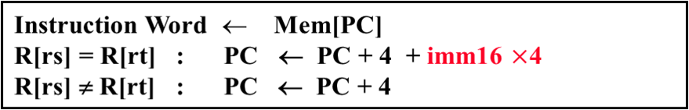
MIPS Branch I-Type Instruction Fields
OP
rs
rt
address
(e.g. offset)
6 bits 5 bits 5 bits 16 bits
imm16
[31:26] [25:21] [20:16] [15:0]
Sign extended address
offset in words
op: Opcode, operation of the instruction.
rs: The first register being compared
rt: The second register being compared.
address: 16-bit memory address branch target offset in words added to PC to form branch address.
Word = 4 bytes
imm16
Register in rt
offset in bytes equal to
instruction address field x 4
OP = 4
Register in rs
Examples:
Branch on equal beq $1,$2, 100
Branch on not equal bne $1,$2, 100
Added
to PC+4 to form
branch target
OP = 5
Independent RTN for beq:
Sign extended
PC-Relative Addressing used (Mode 4)
imm16 = 16 bit immediate field

Slide 14

MIPS J-Type Instruction Fields
J-Type: Include jump j, jump and link jal
OP
jump target
6 bits 26 bits
[31:26] [25:0]
Effective Jump address
offset in words
op: Opcode, operation of the instruction.
  Jump j op = 2
  Jump and link jal op = 3
jump target: jump memory address in words.
Jump j 10000
Jump and link jal 10000
Examples:
Effective 32-bit jump address: PC(31-28),jump_target,00
PC(31-28)
From
PC+4
0 0
jump target = 10000
4 bits 26 bits 2 bits
Independent RTN for j:
Instruction Word ← Mem[PC]
PC ← PC + 4
PC ← PC(31-28),jump_target,00
J-Type = Jump Type Pseudodirect Addressing used (Mode 5)

Slide 15
A Subset of MIPS Instructions
32 = add
34 = sub
31
26
21
16
11
6
0
R
ADD and SUB:
  add rd, rs, rt
  sub rd, rs, rt
OR Immediate:
  ori rt, rs, imm16
LOAD and STORE Word
  lw rt, rs, imm16
  sw rt, rs, imm16
BRANCH:
beq rs, rt, imm16
op
rs
rt
rd
shamt
funct
6 bits
5 bits
5 bits
5 bits
5 bits
6 bits
0
[31:26] [25:21] [20:16] [15:11] [10:6] [5:0]
I
31
26
21
16
0
op
rs
rt
Immediate (imm16)
6 bits
5 bits
5 bits
16 bits
13
[31:26] [25:21] [20:16] [15:0]
I
31
26
21
16
0
op
rs
rt
Immediate (imm16)
6 bits
5 bits
5 bits
16 bits
Offset in bytes
35 = lw
43 = sw
[31:26] [25:21] [20:16] [15:0]
31
26
21
16
0
I
op
rs
rt
Immediate (imm16)
6 bits
5 bits
5 bits
16 bits
Offset in words
4
[31:26] [25:21] [20:16] [15:0]

Slide 16
Basic MIPS Instruction Processing Steps
Instruction/program Memory
}
Instruction
Fetch
Obtain instruction from program storage
Instruction ← Mem[PC]
Next
Instruction
Update program counter to address
of next instruction
Common
steps
for all
instructions
PC ← PC + 4
Instruction
Decode
Determine instruction type
Obtain operands from registers
Execute
Compute result value or status
Done by
Control Unit
(Based on Opcode)
Result
Store
Store result in register/memory if needed
(usually called Write Back).

Slide 17
Logical Register Transfers
RTL gives the meaning of the instructions
All start by fetching the instruction
op | rs | rt | rd | shamt | funct = MEM[ PC ]
op | rs | rt | Imm16 = MEM[ PC ]
inst Register Transfers
ADDU R[rd] <– R[rs] + R[rt]; PC <– PC + 4
SUBU R[rd] <– R[rs] – R[rt]; PC <– PC + 4
ORi R[rt] <– R[rs] | zero_ext(Imm16); PC <– PC + 4
LOAD R[rt] <– MEM[ R[rs] + sign_ext(Imm16)]; PC <– PC + 4
STORE MEM[ R[rs] + sign_ext(Imm16) ] <– R[rt]; PC <– PC + 4
BEQ if ( R[rs] == R[rt] ) then PC <– PC + 4 + sign_ext(Imm16)] || 00 else PC <– PC + 4

Slide 18
Step 1: Requirements of the Instruction Set
Memory
  instruction & data
Registers (32 x 32)
  read RS
  read RT
  Write RT or RD
PC
Extender
Add and Sub register or extended immediate
Add 4 or extended immediate to PC

Slide 19
Step 2: Components of the Datapath
Combinational Elements
Storage(sequential) Elements
  Clocking methodology

Slide 20
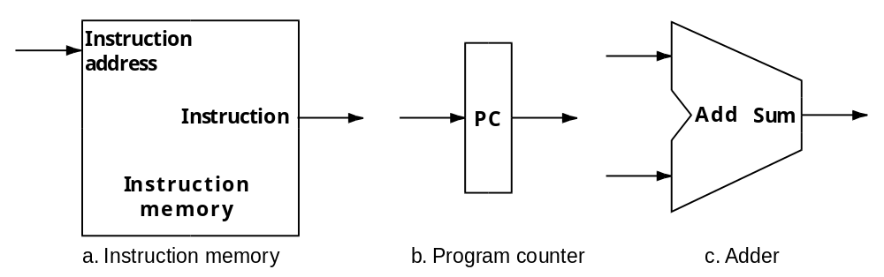
Initial Datapath Components
Three components needed by: Instruction Fetch: Instruction ← Mem[PC]
Program Counter Update: PC ← PC + 4
32
32
32
32
32
32
Instruction
Word
32
32-bit
Two state elements (memory) needed to store and access instructions:
  Instruction memory:
    Only read access (by user code). No read control signal needed.
  Program counter (PC): 32-bit register.
    Written at end of every clock cycle (edge-triggered) : No write control signal needed.
  32-bit Adder: To compute the the next instruction address (PC + 4).
4th Edition Figure 4.5, page 308 - 3rd Edition Figure 5.5, page 293
+ Basics of logic design/logic building blocks review in Appendix C in Book CD (4th Edition Appendix B)

Slide 21
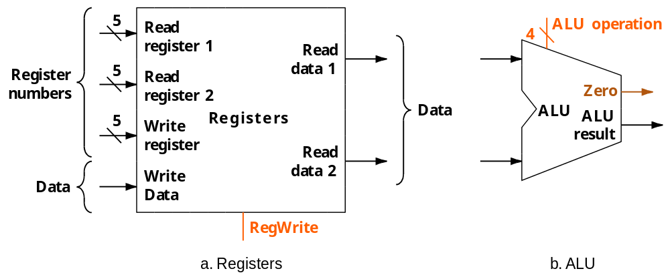
More Datapath Components
ISA Register File
Main 32-bit ALU
e.g add = 0010
R[rs]
(Function)
32
32
R[rt]
32
32
32
32-bit Arithmetic and Logic Unit (ALU)
Register File:
  Contains all ISA registers.
  Two read ports and one write port.
  Register writes by asserting write control signal
  Clocking Methodology: Writes are edge-triggered.
    Thus can read and write to the same register in the same clock cycle.
Zero = Zero flag = 1
When ALU result equals zero
4th Edition Figure 4.7, page 310 - 3rd Edition Figure 5.7, page 295
+ Basics of logic design/logic building blocks review in Appendix C in Book CD (4th Edition Appendix B)

Slide 22
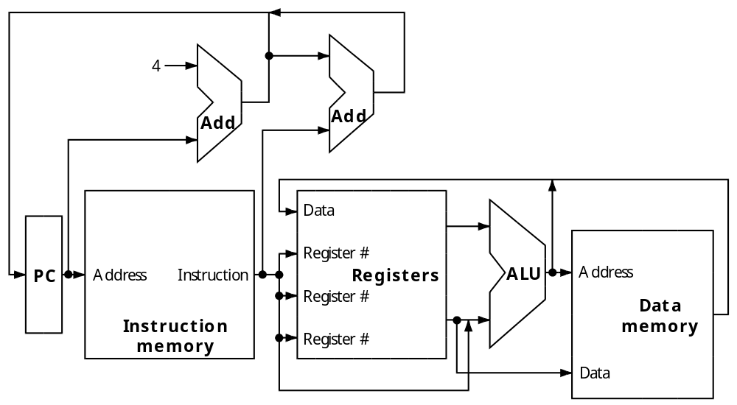
A Single Cycle MIPS CPU Design
Design target: A single-cycle per instruction MIPS CPU design
All micro-operations of an instruction are to be carried out in a single
CPU clock cycle. Cycles Per Instruction = CPI = 1
Abstract view of single cycle MIPS
CPU showing major functional units
(components) and major connections
between them
CPI = 1
32
32
32
32
ISA
32
4th Edition Figure 4.1 page 302 - 3rd Edition Figure 5.1 page 287

Slide 23
Combinational Logic Elements (Basic Building Blocks)
CarryIn
Adder
MUX
ALU
A
32
Adder
Sum
32
B
Carry
32
Select
A
32
MUX
Y
32
B
32
OP
A
32
ALU
Result
32
B
32
Notes:
Based on the Register Transfer Language examples we have so far, we know we will need the following combinational logic elements.
We will need an adder to update the program counter.
A MUX to select the results.
And finally, an ALU to do various arithmetic and logic operation.
+1 = 30 min. (Y:10)

Slide 24
Storage Element: Register (Basic Building Block)
Register
  Similar to the D Flip Flop except
    N-bit input and output
    Write Enable input
  Write Enable:
    negated (0): Data Out will not change
    asserted (1): Data Out will become Data In
Write Enable
Data In
Data Out
N
N
Clk
Notes:
As far as storage elements are concerned, we will need a N-bit register that is similar to the D flip-flop I showed you in class.
The significant difference here is that the register will have a Write Enable input.
That is the content of the register will NOT be updated if Write Enable is not asserted (0).
The content is updated at the clock tick ONLY if the Write Enable signal is asserted (1).
+1 = 31 min. (Y:11)

Slide 25
Storage Element: Idealized Memory
Write Enable
Address
Memory (idealized)
  One input bus: Data In
  One output bus: Data Out
Memory word is selected by:
  Address selects the word to put on Data Out
  Write Enable = 1: address selects the memory
  word to be written via the Data In bus
Clock input (CLK)
  The CLK input is a factor ONLY during write operation
  During read operation, behaves as a combinational logic block:
    Address valid => Data Out valid after “access time.”
Data In
DataOut
32
32
Clk
Notes:
The last storage element you will need for the datapath is the idealized memory to store your data and instructions.
This idealized memory block has just one input bus (DataIn) and one output bus (DataOut).
When Write Enable is 0, the address selects the memory word to put on the Data Out bus.
When Write Enable is 1, the address selects the memory word to be written via the DataIn bus at the next clock tick.
Once again, the clock input is a factor ONLY during the write operation.
During read operation, it behaves as a combinational logic block.
That is if you put a valid value on the address lines, the output bus DataOut will become valid after the access time of the memory.
+2 = 35 min. (Y:15)

Slide 26
Storage Element: Register File
RW
RA
RB
Register File consists of 32 registers:
  Two 32-bit output busses:
  busA and busB
  One 32-bit input bus: busW
Register is selected by:
  RA (number) selects the register to put on busA (data)
  RB (number) selects the register to put on busB (data)
  RW (number) selects the register to be written
  via busW (data) when Write Enable is 1
Clock input (CLK)
  The CLK input is a factor ONLY during write operation
  During read operation, behaves as a combinational logic block:
    RA or RB valid => busA or busB valid after “access time.”
Write Enable
5
5
5
busA
busW
32 32-bit
Registers
32
32
Clk
busB
32
Notes:
We will also need a register file that consists of 32 32-bit registers with two output busses (busA and busB) and one input bus.
The register specifiers Ra and Rb select the registers to put on busA and busB respectively.
When Write Enable is 1, the register specifier Rw selects the register to be written via busW.
In our simplified version of the register file, the write operation will occurs at the clock tick.
Keep in mind that the clock input is a factor ONLY during the write operation.
During read operation, the register file behaves as a combinational logic block.
That is if you put a valid value on Ra, then bus A will become valid after the register file’s access time.
Similarly if you put a valid value on Rb, bus B will become valid after the register file’s access time. In both cases (Ra and Rb), the clock input is not a factor.
+2 = 33 min. (Y:13)

Slide 27
Clocking Methodology Used: Edge Triggered Writes
Here writes are triggered on the rising edge of the clock
Clk
Setup
Hold
Setup
Hold
Don’t Care
CLK-to-Q
CLK-to-Q
.
.
.
.
.
.
.
.
.
.
.
.
Critical Path (Longest delay path) = One cycle time !
Clock
Clock
All storage element (e.g Flip-Flops, Registers, Data Memory) writes are triggered by the same clock edge.
Cycle Time = CLK-to-Q + Longest Delay Path + Setup + Clock Skew
(CLK-to-Q + Shortest Delay Path - Clock Skew) > Hold Time

Slide 28
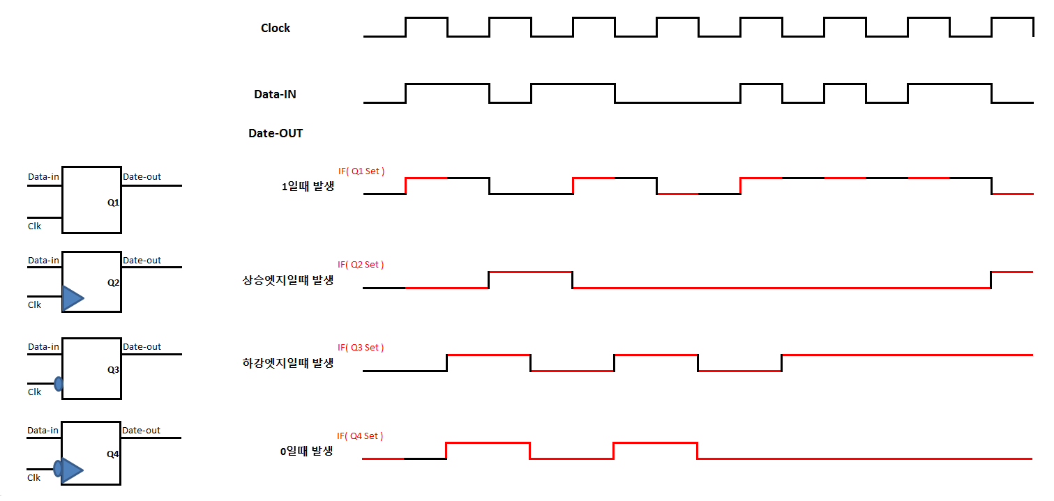
Example :

Slide 29
Step 3: Assemble DataPath meeting our requirements
Register Transfer Requirements
⇒ Datapath Assembly
Instruction Fetch
Read Operands and Execute Operation

Slide 30
3a: Overview of the Instruction Fetch Unit
The common RTL operations
  Fetch the Instruction: mem[PC]
  Update the program counter:
    Sequential Code: PC <- PC + 4
    Branch and Jump: PC <- “something else” ???
Clk
PC
Next Address
Logic
Address
Instruction Word
Instruction
Memory
32
Notes:
Now let’s take a look at the first major component of the datapath: the instruction fetch unit.
The common RTL operations for all instructions are:
(a) Fetch the instruction using the Program Counter (PC) at the beginning of an
instruction’s execution (PC -> Instruction Memory -> Instruction Word).
(b) Then at the end of the instruction’s execution, you need to update the
Program Counter (PC -> Next Address Logic -> PC).
More specifically, you need to increment the PC by 4 if you are executing sequential code.
For Branch and Jump instructions, you need to update the program counter to “something else” other than plus 4.
I will show you what is inside this Next Address Logic block when we talked about the Branch and Jump instructions.
For now, let’s focus our attention to the Add and Subtract instructions.
+2 = 37 min. (Y:17)

Slide 31
3b: Add & Subtract
R[rd] <- R[rs] op R[rt] Example: addU rd, rs, rt
  Ra, Rb, and Rw come from instruction’s rs, rt, and rd fields
  ALUctr and RegWr: control logic after decoding the instruction (opcode ? )
31
26
21
16
11
6
0
op
rs
rt
rd
shamt
funct
6 bits
5 bits
5 bits
5 bits
5 bits
6 bits
Rd
Rs
Rt
RegWr
ALUctr
5
5
5
busA
Rw
Ra
Rb
busW
32
Result
32
32 32-bit
Registers
ALU
32
Clk
busB
32
Notes:
And here is the datapath that can do the trick.
First of all, we connect the register file’s Ra, Rb, and Rw input to the Rd, Rs, and Rt fields of the instruction bus (points to the format diagram).
Then we need to connect busA and busB of the register file to the ALU.
Finally, we need to connect the output of the ALU to the input bus of the register file.
Conceptually, this is how it works.
The instruction bus coming out of the Instruction memory will set the Ra and Rb to the register specifiers Rs and Rt.
This causes the register file to put the value of register Rs onto busA and the value of register Rt onto busB, respectively.
By setting the ALUctr appropriately, the ALU will perform either the Add and Subtract for us.
The result is then fed back to the register file where the register specifier Rw should already be set to the instruction bus’s Rd field.
Since the control, which we will design in our next lecture, should have already set the RegWr signal to 1, the result will be written back to the register file at the next clock tick (points to the Clk input).
+3 = 42 min. (Y:22)

Slide 32
Register-Register Timing: One complete cycle ( R-Type)
Clk
Clk-to-Q
PC
Old Value
New Value
Instruction Memory Access Time
Rs, Rt, Rd,
Op, Func
Old Value
New Value
Delay through Control Logic
1
ALUctr
Old Value
New Value
2
RegWr
Old Value
New Value
Register File Access Time
busA, B
Old Value
New Value
ALU Delay
3
busW
Old Value
New Value
Rd
Rs
Rt
1
Register Write
Occurs Here
2
ALUctr
RegWr
5
5
5
busA
All register
writes occur on
falling edge of clock
(clocking methodology)
3
Rw
Ra
Rb
busW
32 32-bit
Registers
32
Result
32
ALU
busB
32
Clk
32
Notes:
Let’s take a more quantitative picture of what is happening.
At each clock tick, the Program Counter will present its latest value to the Instruction memory after Clk-to-Q time.
After a delay of the Instruction Memory Access time, the Opcode, Rd, Rs, Rt, and Function fields will become valid on the instruction bus.
Once we have the new instruction, that is the Add or Subtract instruction, on the instruction bus, two things happen in parallel.
First of all, the control unit will decode the Opcode and Func field and set the control signals ALUctr and RegWr accordingly. We will cover this in the next lecture.
While this is happening (points to Control Delay), we will also be reading the register file (Register File Access Time).
Once the data is valid on busA and busB, the ALU will perform the Add or Subtract operation based on the ALUctr signal.
Hopefully, the ALU is fast enough that it will finish the operation (ALU Delay) before the next clock tick.
At the next clock tick, the output of the ALU will be written into the register file because the RegWr signal will be equal to 1.
+3 = 45 min. (Y:25)

Slide 33
3c: Logical Operations with Immediate
R[rt] <- R[rs] op ZeroExt[imm16] ]
31
26
21
16
11
0
op
rs
rt
immediate
6 bits
5 bits
5 bits
rd?
16 bits
31
16
15
0
0 0 0 0 0 0 0 0 0 0 0 0 0 0 0 0
immediate
16 bits
16 bits
Rd
Rt
RegDst
Mux
Rs
Rt?
ALUctr
RegWr
5
5
5
busA
Rw
Ra
Rb
busW
32
Result
32 32-bit
Registers
32
ALU
32
Clk
busB
32
Mux
imm16
ZeroExt
16
32
ALUSrc
Notes:
Here is the datapath for the Or immediate instructions.
We cannot use the Rd field here (Rw) because in this instruction format, we don’t have a Rd field. The Rd field in the R-type is used here as part of the immediate field.
For this instruction type, Rw input of the register file, that is the address of the register to be written, comes from the Rt field of the instruction.
Recalled from earlier slide that for R-type instruction, the Rw comes from the Rd field.
That’s why we need a MUX here to put Rd onto Rw for R-type instructions and to put Rt onto Rw for the I-type instruction.
Since the second operation of this instruction will be the immediate field zero extended to 32 bits, we also need a MUX here to block off bus B from the register file.
Since bus B is blocked off by the MUX, the value on bus B is don’t care. Therefore we do not have to worry about what ends up on the register file’s Rb register specifier.
To keep things simple, we may just as well keep it the same as the R-type instruction and put the Rt field here.
So to summarize, this is how this datapath works. With Rs on Register File’s Ra input, bus A will get the value of Rs as the first ALU operand.
The second operand will come from the immediate field of the instruction.
Once the ALU complete the OR operation, the result will be written into the register specified by the instruction’s Rt field.
+3 = 50 min. (Y:30)

Slide 34
3d: Load Operations
R[rt] <- Mem[R[rs] + SignExt[imm16]] Example: lw rt, rs, imm16
31
26
21
16
11
0
op
rs
rt
immediate
6 bits
5 bits
5 bits
rd
16 bits
Rd
Rt
RegDst
Mux
Rs
Rt?
RegWr
ALUctr
5
5
5
busA
W_Src
Rw
Ra
Rb
busW
32
32 32-bit
Registers
32
ALU
32
Clk
busB
MemWr
32
Mux
Mux
WrEn
Adr
??
Data In
32
Extender
Data
Memory
imm16
32
32
16
ALUSrc
Clk
ExtOp
Notes:
Once again we cannot use the instruction’s Rd field for the Register File’s Rw input because load is a I-type instruction and there is no such thing as the Rd field in the I format.
So instead of Rd, the Rt field is used to specify the destination register through this two to one multiplexor.
The first operand of the ALU comes from busA of the register file which contains the value of Register Rs (points to the Ra input of the register file).
The second operand, on the other hand, comes from the immediate field of the instruction.
Instead of using the Zero Extender I used in datapath for the or immediate datapath, I have to use a more general purpose Extender that can do both Sign Extend and Zero Extend.
The ALU then adds these two operands together to form the memory address.
Consequently, the output of the ALU has to go to two places:
(a) First the address input of the data memory.
(b) And secondly, also to the input of this two-to-one multiplexer.
The other input of this multiplexer comes from the output of the data memory so we can place the output of the data memory onto the register file’s input bus for the load instruction.
For Add, Subtract, and the Or immediate instructions, the output of the ALU will be selected to be placed on the input bus of the register file.
In either case, the control signal RegWr should be asserted so the register file will be written at the end of the cycle.
+3 = 60 min. (Y:40)

Slide 35
3e: Store Operations
Mem[ R[rs] + SignExt[imm16] <- R[rt] ] Example: sw rt, rs, imm16
31
26
21
16
0
op
rs
rt
immediate
6 bits
5 bits
5 bits
16 bits
Rd
Rt
ALUctr
MemWr
W_Src
RegDst
Mux
Rs
Rt
RegWr
5
5
5
busA
Rw
Ra
Rb
busW
32
32 32-bit
Registers
32
ALU
32
Clk
busB
32
Mux
Mux
WrEn
Adr
Data In
32
32
imm16
Extender
Data
Memory
16
32
Clk
ExtOp
ALUSrc
Notes:
And here is the datapath for the store instruction.
The Register File, the ALU, and the Extender are the same as the datapath for the load instruction because the memory address has to be calculated the same exact way:
(a) Put the register selected by Rs onto bus A and sign extend the 16 bit immediate field.
(b) Then make the ALU (ALUctr) adds these two (busA and output of Extender) together.
The new thing we added here is busB extension (DataIn).
More specifically, in order to send the register selected by the Rt field (Rb of the register file) to data memory, we need to connect bus B to the data memory’s Data In bus.
Finally, the store instruction is the first instruction we encountered that does not do any register write at the end.
Therefore the control unit must make sure RegWr is zero for this instruction.
+2 = 64 min. (Y:44)

Slide 36
3f: The Branch Instruction
31
26
21
16
0
op
rs
rt
immediate
6 bits
5 bits
5 bits
16 bits
beq rs, rt, imm16
  mem[PC] Fetch the instruction from memory
  Equal <- R[rs] == R[rt] Calculate the branch condition
  if (Equal) Calculate the next instruction’s address
    PC <- PC + 4 + ( SignExt(imm16) x 4 )
  else
    PC <- PC + 4
Notes:
How does the branch on equal instruction work?
Well it calculates the branch condition by subtracting the register selected by the Rt field from the register selected by the Rs field.
If the result of the subtraction is zero, then these two registers are equal and we take a branch. Otherwise, we keep going down the sequential path (PC <- PC +4).
+1 = 65 min. (Y:45)

Slide 37
Datapath for Branch Operations
beq rs, rt, imm16 Datapath generates condition (equal)
31
26
21
16
0
op
rs
rt
immediate
6 bits
5 bits
5 bits
16 bits
Branch
Inst Address
Cond (zero)
Zero
nPC_sel
Rs
Rt
4
RegWr
5
5
5
Adder
32
busA
Rw
Ra
Rb
00
busW
32 32-bit
Registers
32
Equal?
Mux
PC
Clk
busB
32
Adder
imm16
PC Ext
Clk
Sign extend
shift left 2
Notes:
The datapath for calculating the branch condition is rather simple.
All we have to do is feed the Rs and Rt fields of the instruction into the Ra and Rb inputs of the register file.
Bus A will then contain the value from the register selected by Rs.
And bus B will contain the value from the register selected by Rt.
The next thing to do is to ask the ALU to perform a subtract operation and feed the output Zero to the next address logic.
How does the next address logic block look like?
Well, before I show you that, let’s take a look at the binary arithmetics behind the program counter (PC).
+2 = 67 min. (Y:47)

Slide 38
Instruction<31:0>
Instruction
Memory
<21:25>
<21:25>
<16:20>
<11:15>
<0:15>
<0:25>
Adr
Op
Fun
Rt
Rs
Rd
Imm16
Jump_target
Control Unit
Control Lines
Mem
Read
Mem
Write
ALOp
(2-bits)
RegDst
ALUSrc
MemtoReg
RegWrite
Branch
DATA PATH

Slide 39
Putting it All Together: A Single Cycle Datapath
Inst
Memory
Instruction<31:0>
<21:25>
<16:20>
<11:15>
<0:15>
Adr
Rs
Rt
Rd
Imm16
nPC_sel
RegDst
ALUctr
MemWr
MemtoReg
Rd
Rt
Equal
1
0
4
Rs
Rt
RegWr
5
5
5
Adder
busA
00
busW
Rw
Ra
Rb
=
32 32-bit
Registers
32
Mux
32
busB
ALU
0
PC
0
32
32
Mux
Mux
Adder
Clk
32
WrEn
Adr
1
1
Data In
PC Ext
imm16
Extender
Data
Memory
Clk
16
32
imm16
Clk
ExtOp
ALUSrc
Notes:
So here is the single cycle datapath we just built.
If you push into the Instruction Fetch Unit, you will see the last slide showing the PC, the next address logic, and the Instruction Memory.
Here I have shown how we can get the Rt, Rs, Rd, and Imm16 fields out of the 32-bit instruction word.
The Rt, Rs, and Rd fields will go to the register file as register specifiers while the Imm16 field will go to the Extender where it is either Zero and Sign extended to 32 bits.
The signals ExtOp, ALUSrc, ALUctr, MemWr, MemtoReg, RegDst, RegWr, Branch, and Jump are control signals.
And I will show you how to generate them on Friday.
+2 = 80 min. (Z:00)

Slide 40
An Abstract View of the Critical Path
Register file and ideal memory:
  The CLK input is a factor ONLY during write operation
  During read operation, behave as combinational logic:
    Address valid => Output valid after “access time.”
Critical Path (Load Operation) =
PC’s Clk-to-Q +
Instruction Memory’s Access Time +
Register File’s Access Time +
ALU to Perform a 32-bit Add +
Data Memory Access Time +
Setup Time for Register File Write +
Clock Skew
Ideal
Instruction
Memory
Instruction
Rd
Rs
Rt
Imm
5
5
5
16
Instruction
Address
A
Data
Address
Rw
Ra
Rb
32
32
32
Ideal
Data
Memory
32 32-bit
Registers
ALU
PC
Next Address
Data In
B
Clk
Clk
Clk
32
Notes:
Now with the clocking methodology back in your mind, we can think about how the critical path of our “abstract” datapath may look like.
One thing to keep in mind about the Register File and Ideal Memory (points to both Instruction and Data) is that the Clock input is a factor ONLY during the write operation.
For read operation, the CLK input is not a factor. The register file and the ideal memory behave as if they are combinational logic.
That is you apply an address to the input, then after certain delay, which we called access time, the output is valid.
We will come back to these points (point to the “behave” bullets) later in this lecture.
But for now, let’s look at this “abstract” datapath’s critical path which occurs when the datapath tries to execute the Load instruction.
The time it takes to execute the load instruction are the sum of:
(a) The PC’s clock-to-Q time.
(b) The instruction memory access time.
(c) The time it takes to read the register file.
(d) The ALU delay in calculating the Data Memory Address.
(e) The time it takes to read the Data Memory.
(f) And finally, the setup time for the register file and clock skew.
+3 = 21 (Y:01)

Slide 41
An Abstract View of the Implementation
Control
Ideal
Instruction
Memory
Instruction
Control Signals
Conditions
Rd
Rs
Rt
5
5
5
Instruction
Address
A
Data
Address
Rw
Ra
Rb
32
Data
Out
32
32
Ideal
Data
Memory
32 32-bit
Registers
ALU
PC
Next Address
Data In
B
Clk
32
Clk
Clk
Datapath
Notes:
One thing you may noticed from our last slide is that almost all instructions, except Jump, require reading some registers, do some computation, and then do something else.
Therefore our datapath will look something like this.
For example, if we have an add instruction (points to the output of Instruction Memory), we will read the registers from the register file (Ra, Rb and then busA and busB).
Add the two numbers together (ALU) and then write the result back to the register file.
On the other hand, if we have a load instruction, we will first use the ALU to calculate the memory address.
Once the address is ready, we will use it to access the Data Memory.
And once the data is available on Data Memory’s output bus, we will write the data to the register file. Well, this is simple enough.
But if it is this simple, you probably won’t need to take this class.
So in today’s lecture, I will show you how to turn this abstract datapath into a real datapath by making it slightly (JUST slightly) more complicated so it can do real work for you.
But before we do that, let’s do a quick review of the clocking methodology
+3 = 16 (X:56)

Slide 42
Steps 4 & 5: Implement the control
Next time

Slide 43
Summary
5 steps to design a processor
  1. Analyze instruction set => datapath requirements
  2. Select set of datapath components & establish clock methodology
  3. Assemble datapath meeting the requirements
  4. Analyze implementation of each instruction to determine setting of control points that effects the register transfer.
  5. Assemble the control logic
MIPS makes it easier
  Instructions same size
  Source registers always in same place
  Immediates same size, location
  Operations always on registers/immediates
Single cycle datapath => CPI=1, CCT => long
Next time: implementing control

